Slide 1

Stage 4 Presentation
Team E
Gaby Gonzaga
Navjeet Hundal
Kim Nguyen
Chevy O'Dell
Manny Rodriguez
TA: Hessam Djavaherpour
Notes:
“Hi my name is Kim and this is Team E's presentation. Our team consists of Gaby, Navjeet, Chevy, Manny and myself”
“Our supervising TA is Hessam and our project is cARe!”

Slide 2
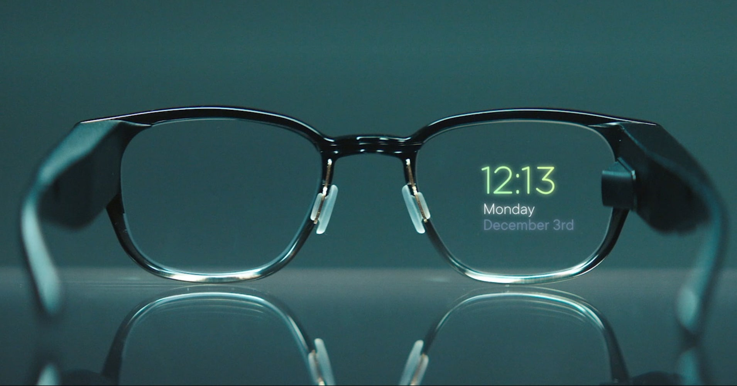
cARe
Augmented reality (AR)
Users include doctors, nurses, EMTs
Interact with hand gestures
“Using AR with cARe!”
Notes:
“CARE, is an augmented reality (AR) application designed for AR equipped glasses to visually show a patient’s relevant medical information to tending healthcare professionals. These healthcare professionals include doctors, nurses, EMTs, and any other healthcare worker who needs to see a patient’s information quickly and hands-free.
Users would interact with the system through specific hand movements such as swiping to close the app’s windows as if interacting with a tablet or dragging a patient’s name to the center of the screen to see a more detailed readout of their information.
We expect our product to be used in various settings such as in hospitals, by paramedics responding to 911 calls, medical offices, and anywhere healthcare workers are needed.
For our hi-fi prototype we chose to implement 4 of our tasks vertically.

Slide 3




Tasks
1
2
Display patient’s vitals in real-time
Display patient’s
health history
3
4
Check diagnostic test results
Add notes and edit a to-do list
Notes:
The tasks we’ve chosen include:
Displaying a patient’s current body temperature, pulse rate, respiration rate, and blood pressure in real time.
Pulling up a patient's health history such as medication, allergies, and previous surgeries.
Viewing and interacting with recent and past diagnostic test results. Including diagnostic images and text information such as X-rays and Blood tests.
And finally
- Adding notes about a patient’s progress, prognosis, treatment, etc. Creating to-do lists or treatment plans for specific patients.

Slide 4
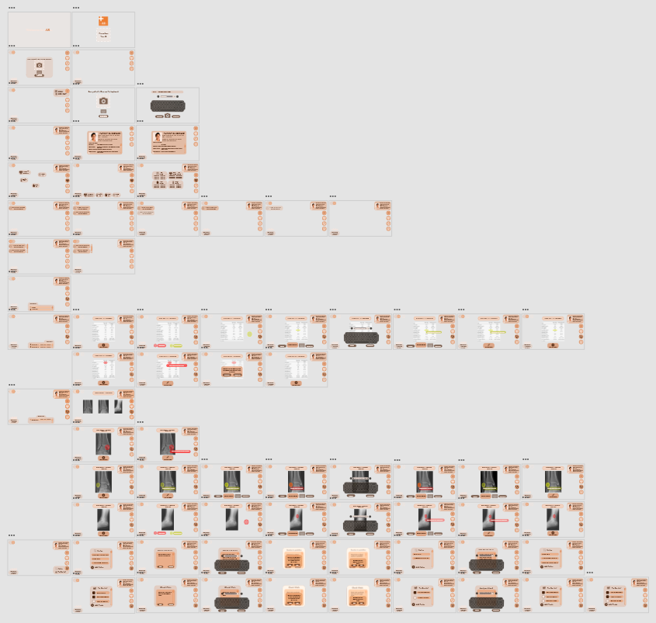

Hi-fi Prototype Software Used
Notes:
To turn our tasks into a polished hi-fi prototype we used Adobe XD to create the UI frames that would then be placed over a video to simulate the view from an AR headset.
We ended up having over 60 frames as shown in the zoomed out adobe file on the right.
“To see these in action I’ll pass this over to Gaby.”

Slide 5
EMBED VIDEO
Notes:
*Play demo video*

Slide 6


Heuristic Evaluation Process
Split the Team into 2 sub-groups
Evaluators evaluating off the provided templates
Reviewers revising evaluators ideas and deciding on problems to fix
New problem priority and a plan to fix them
Regroup and discuss each heuristic

Slide 7

Heuristic Evaluation Findings
Lack of clarity within the system
Insufficient human error safety net
Language does not fully match healthcare niche
Similarities within sub-menus

Slide 8
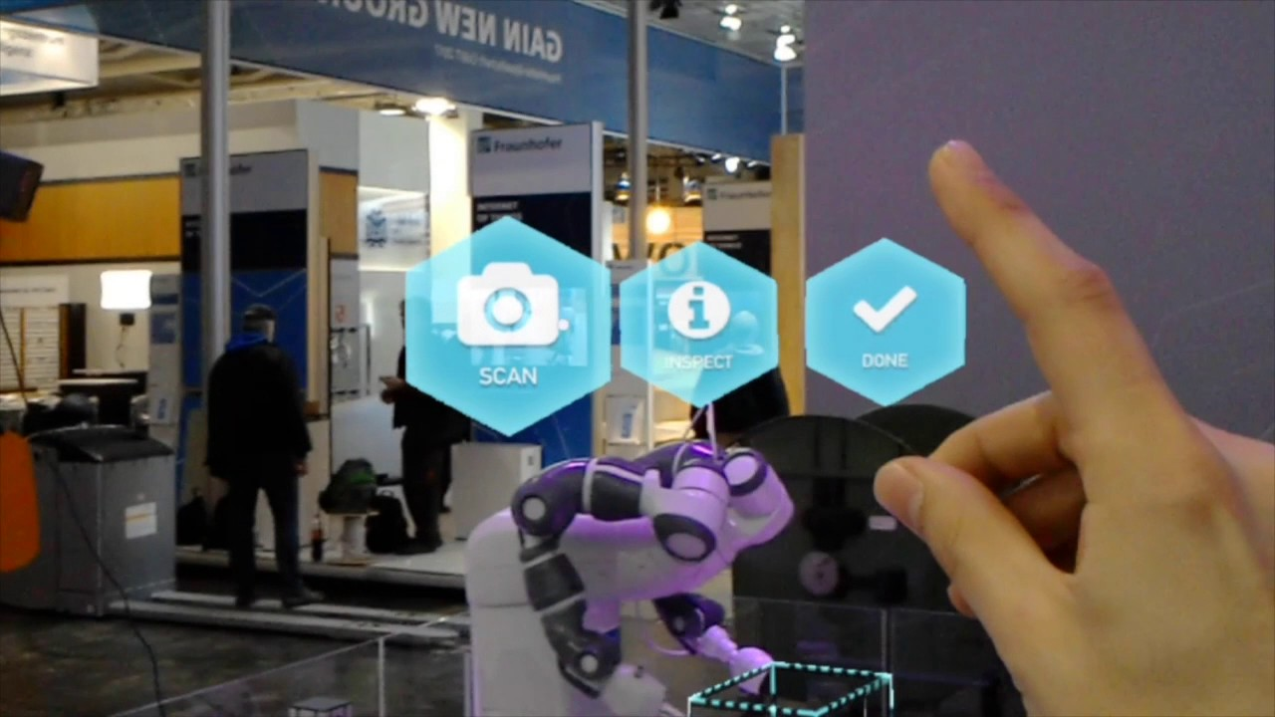
Heuristic Evaluation Discussion
Create a consistent set up for everyone
Add components that improve error handling
Use healthcare related vocabulary
Represent interactions of certain elements
Adding visual tabs to differentiate sub menus

Slide 9
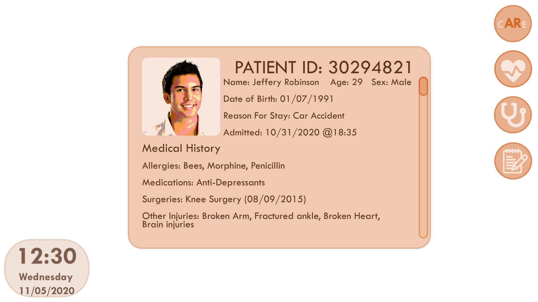
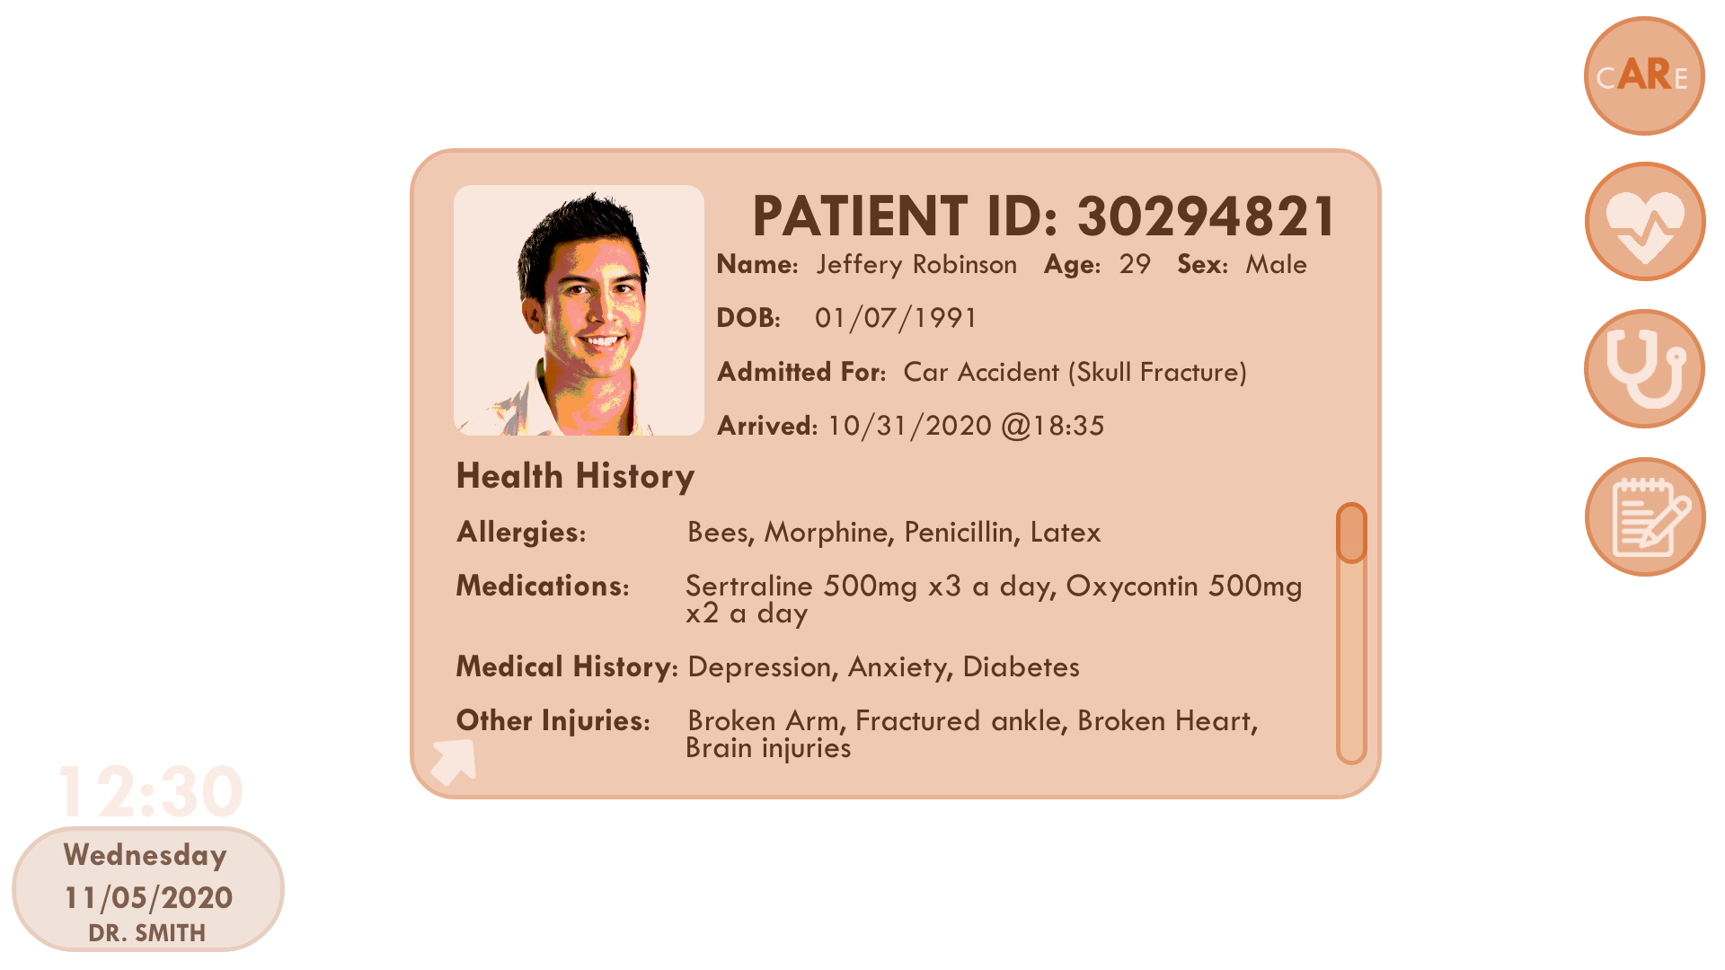
Prototypes: Before and After Evaluation

Slide 10
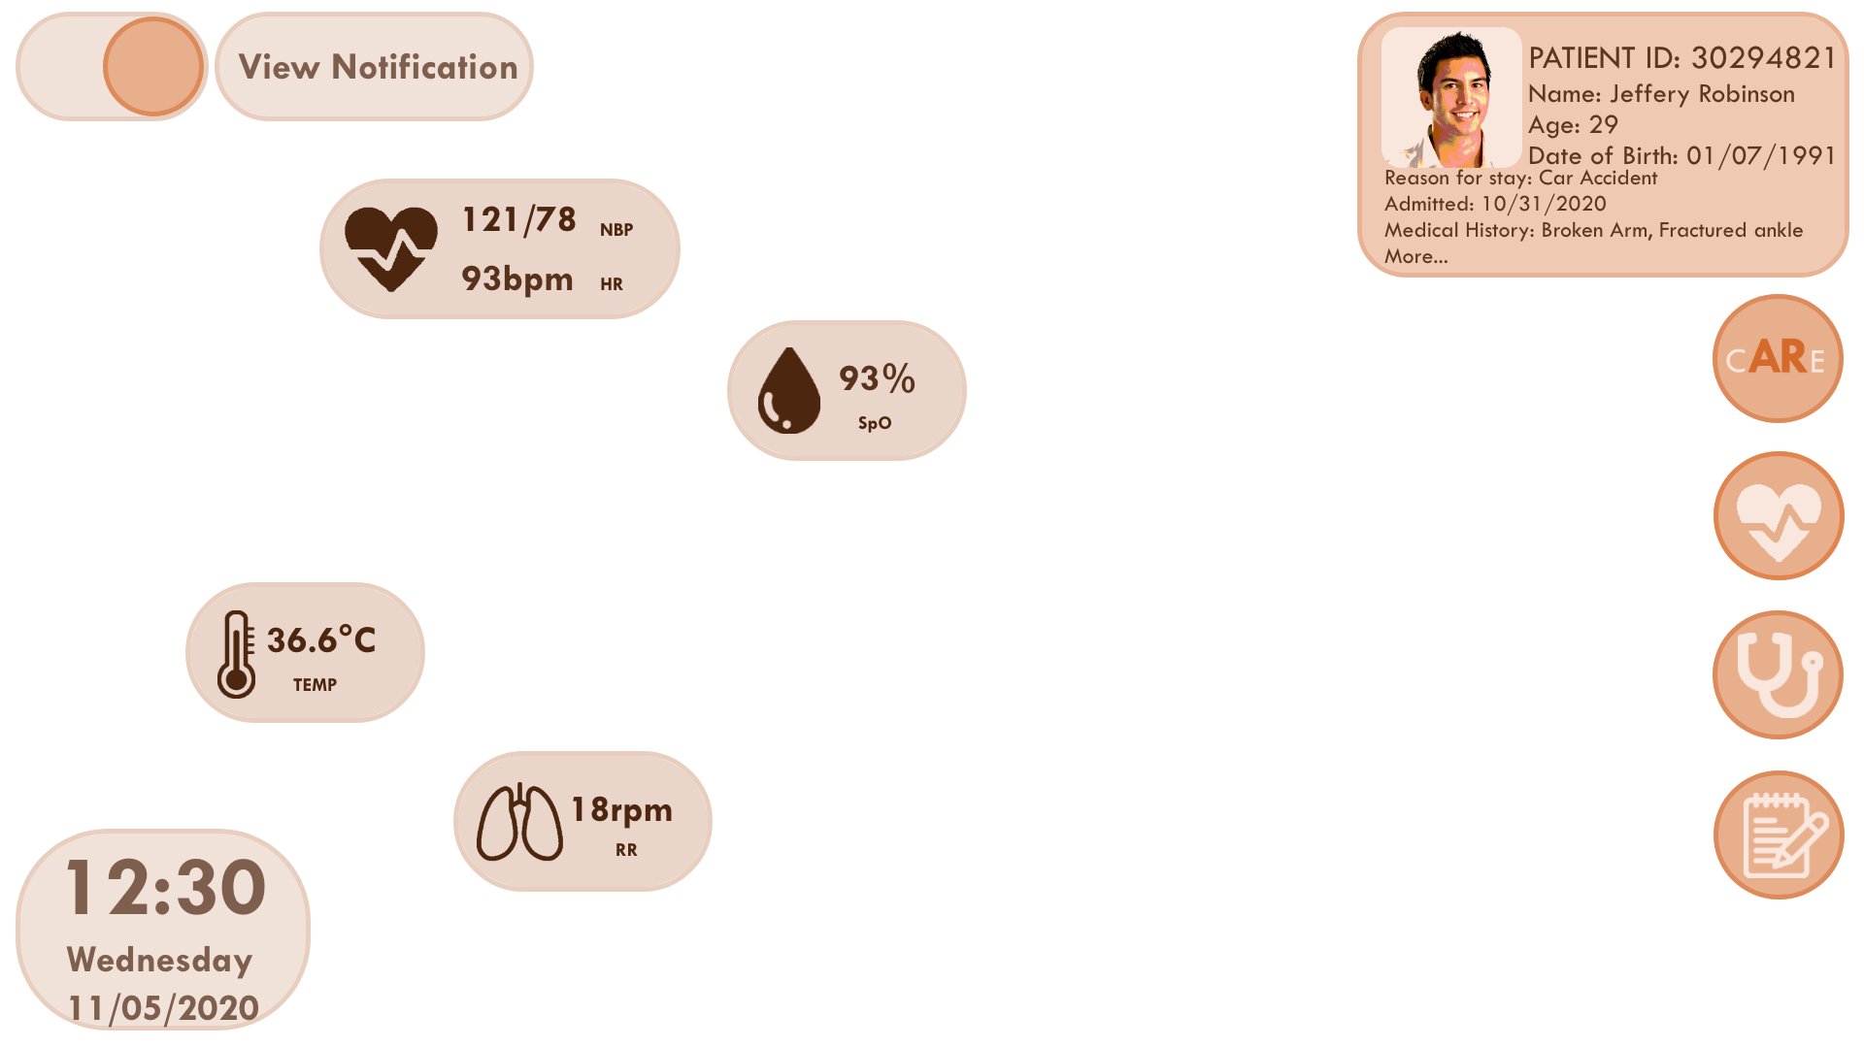
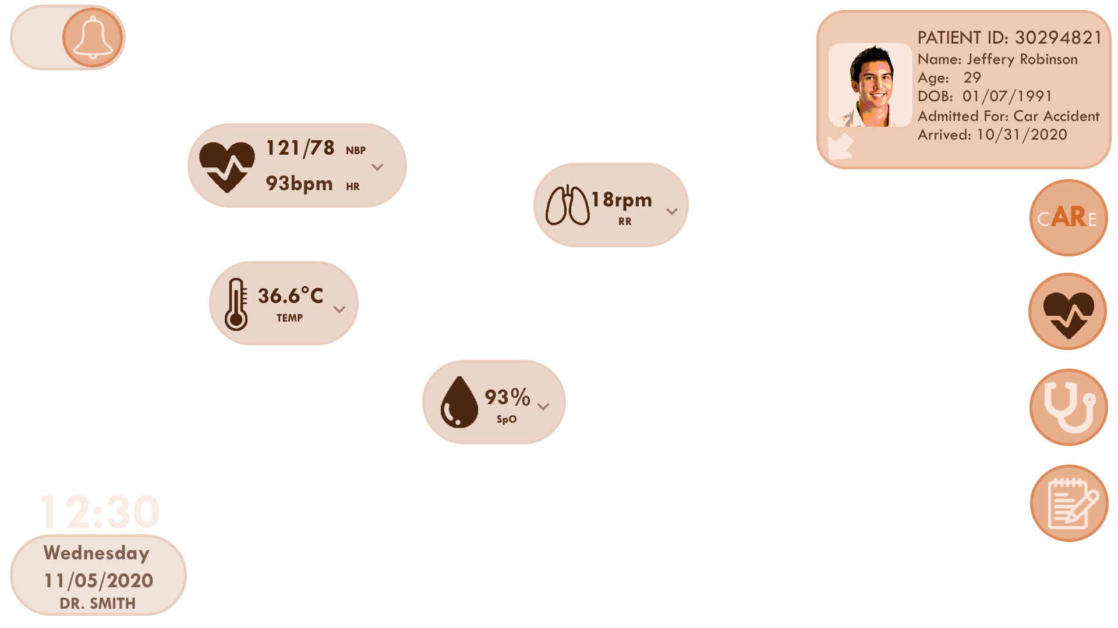
Prototypes: Before and After Evaluation

Slide 11
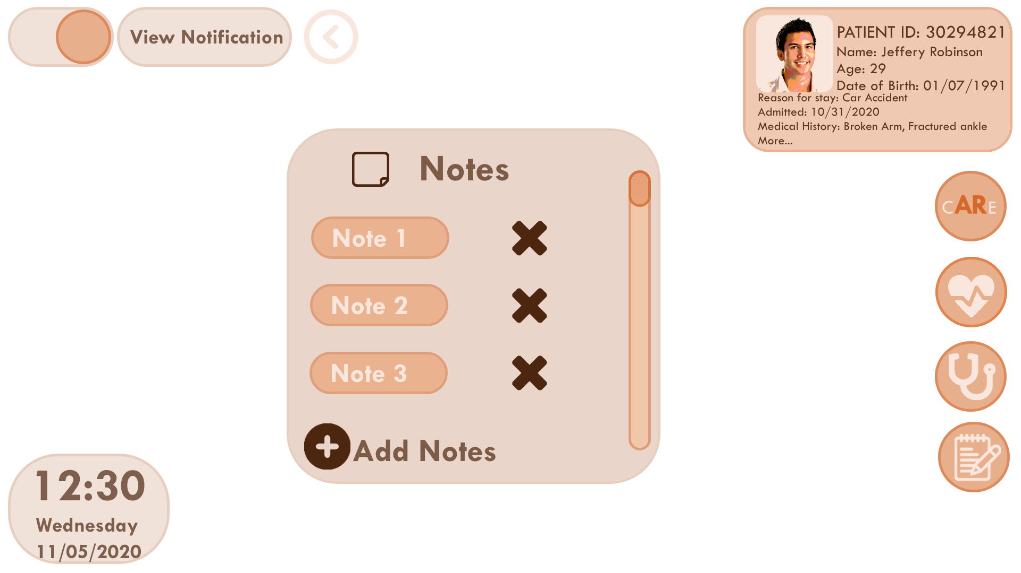
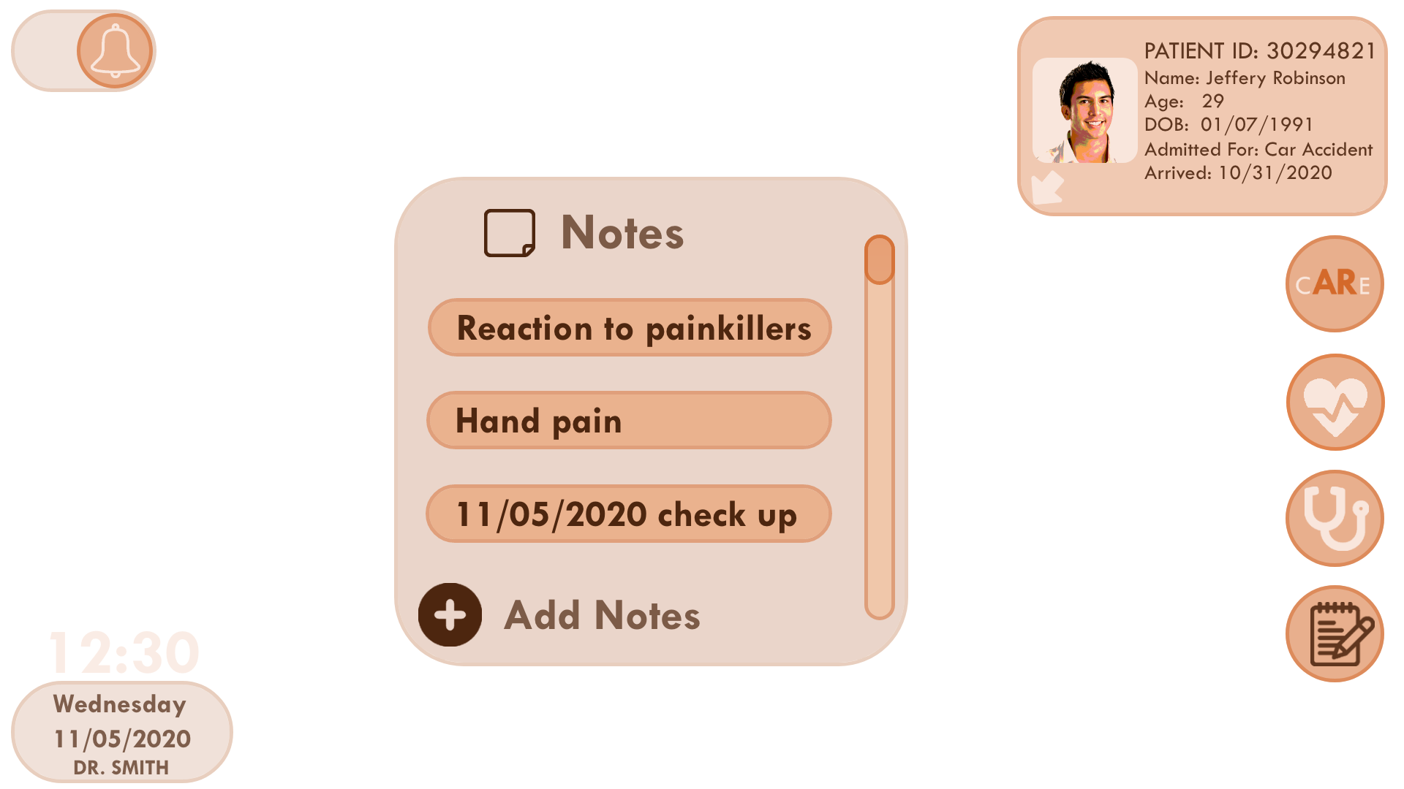
Prototypes: Before and After Evaluation

Slide 12
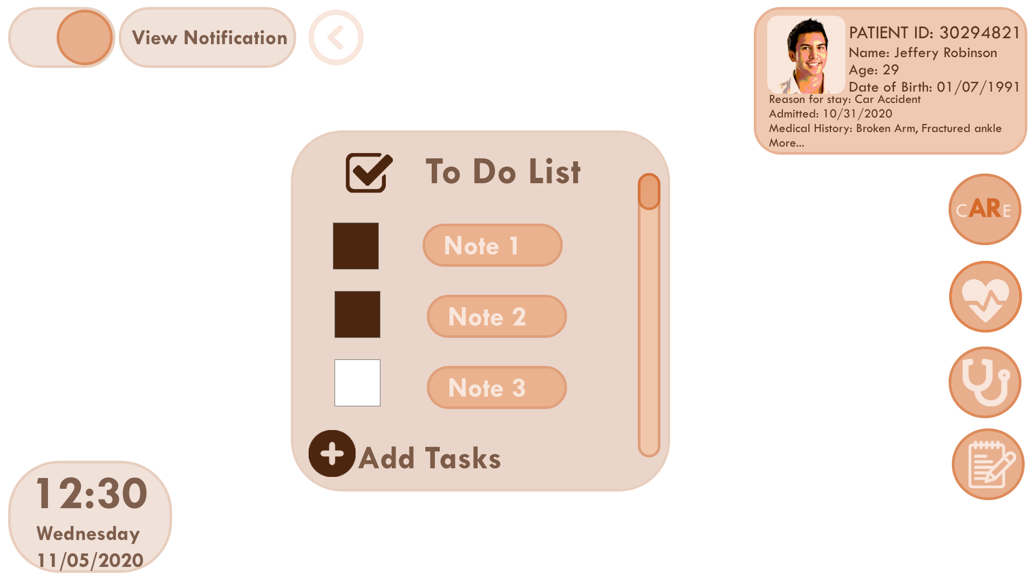
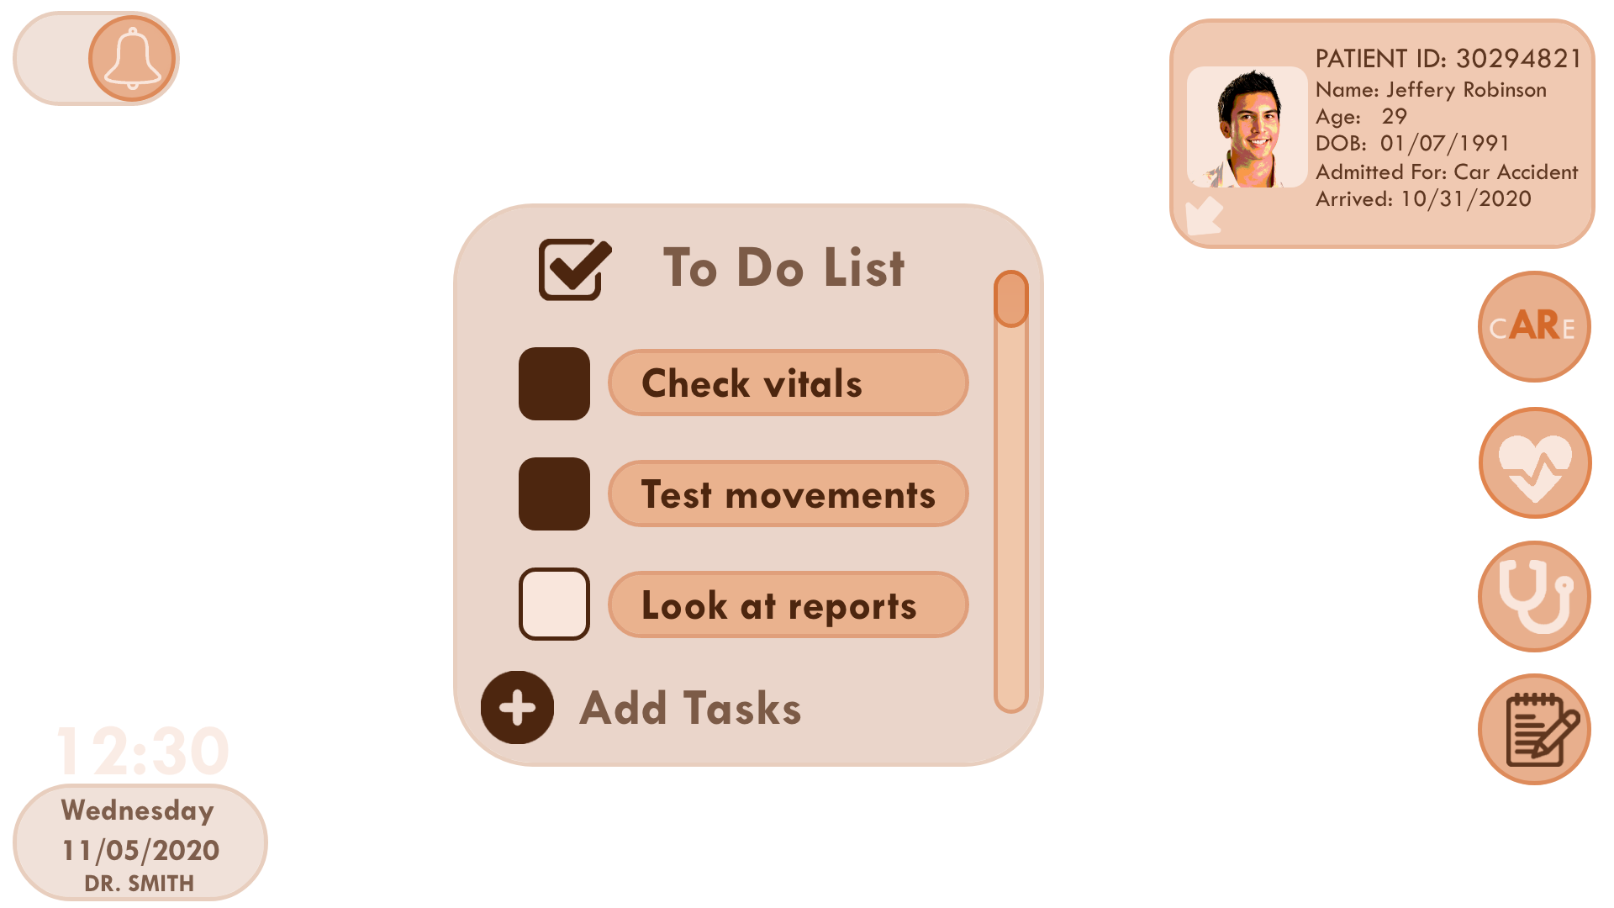
Prototypes: Before and After Evaluation

Slide 13
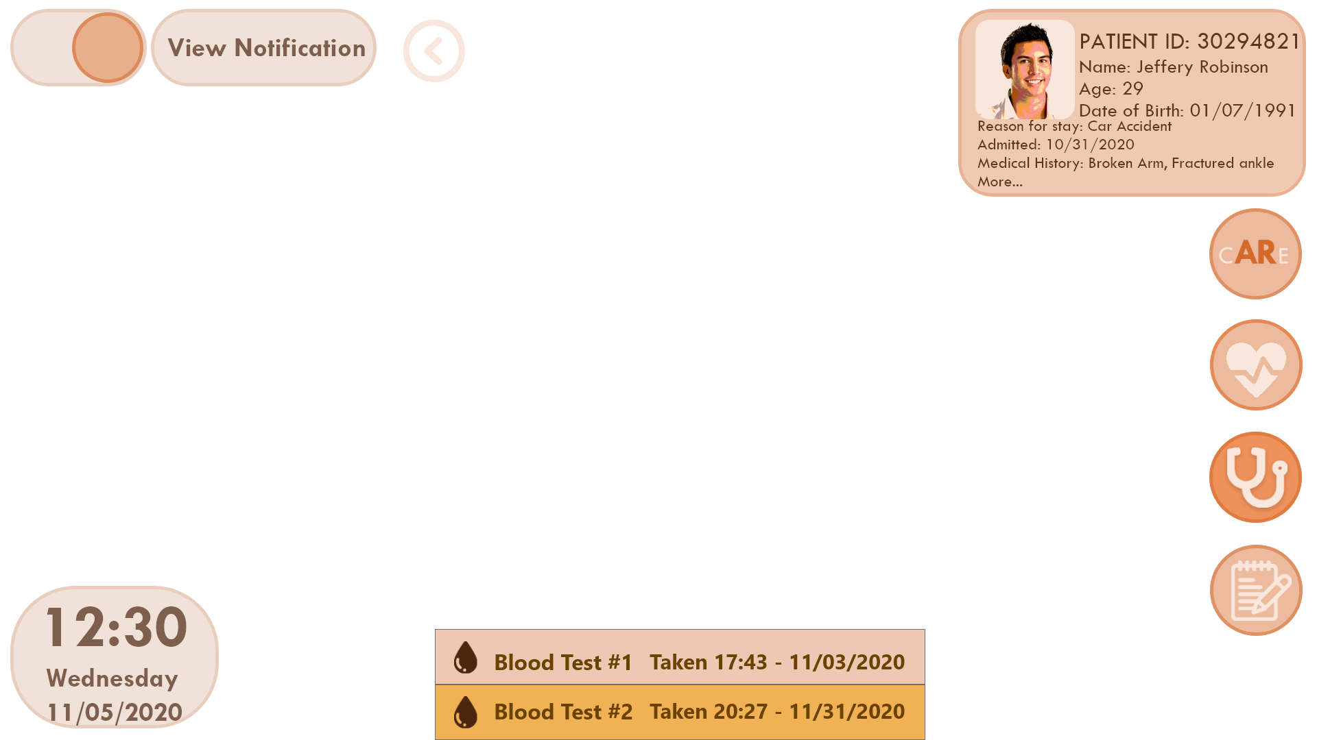
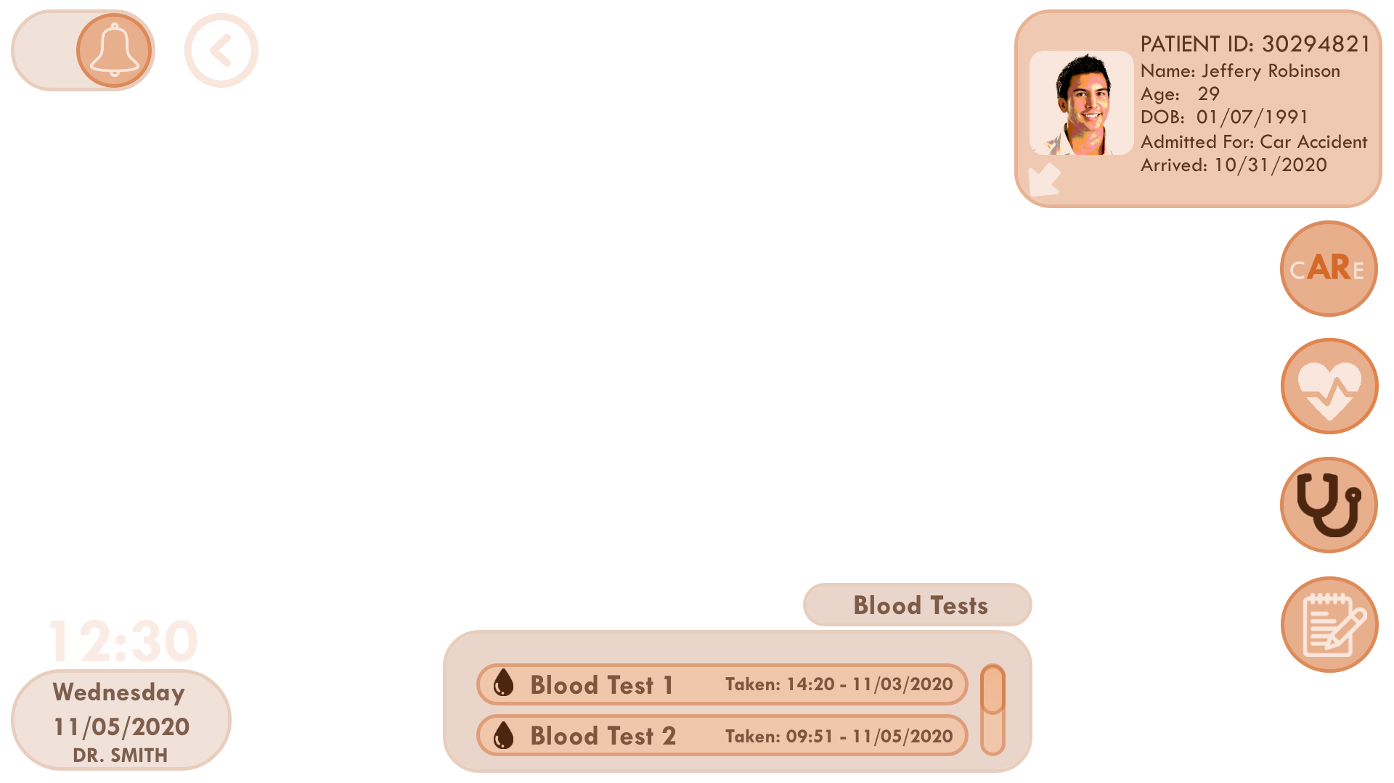
Prototypes: Before and After Evaluation

Slide 14
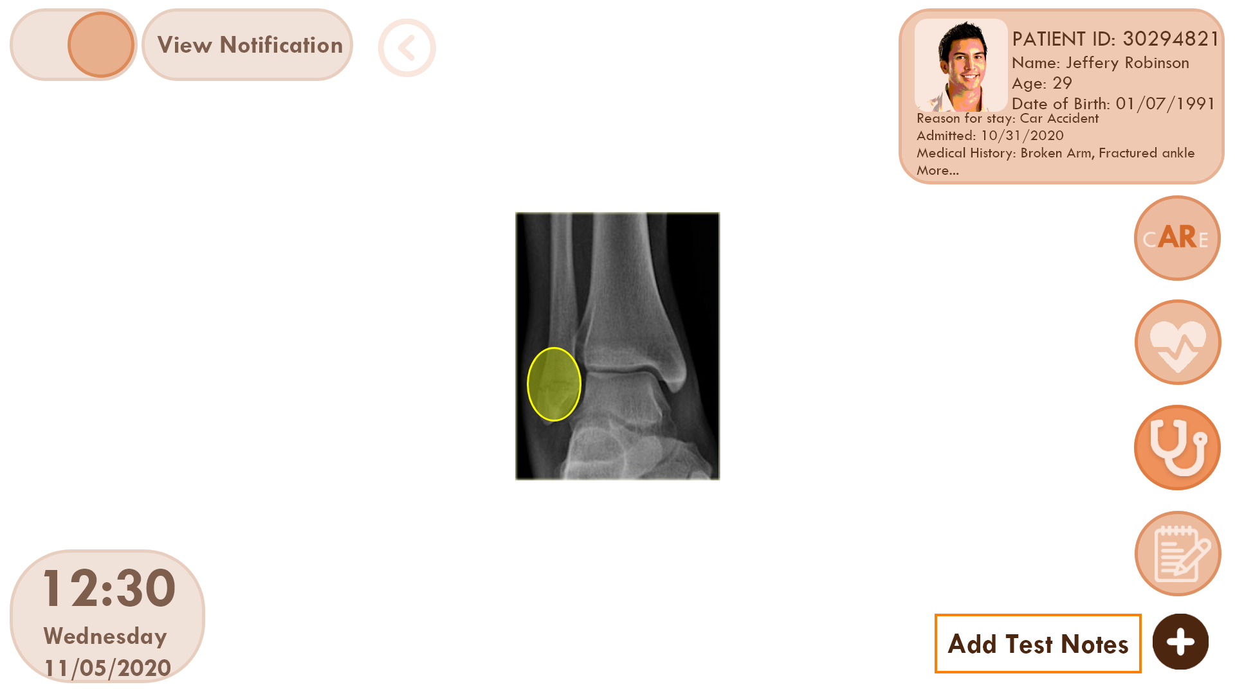
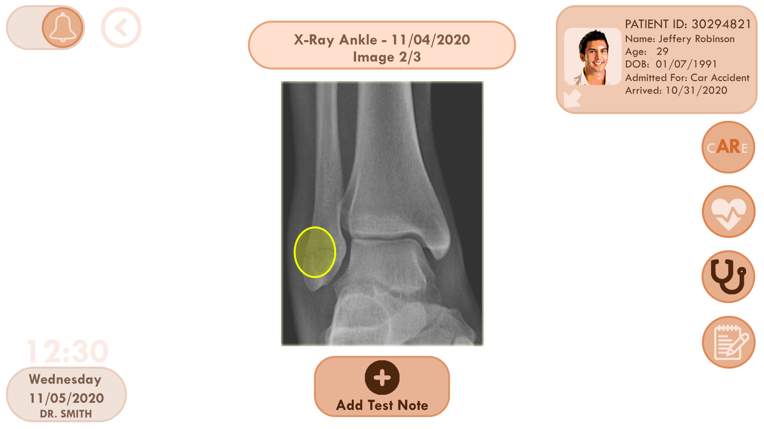
Prototypes: Before and After Evaluation

Slide 15
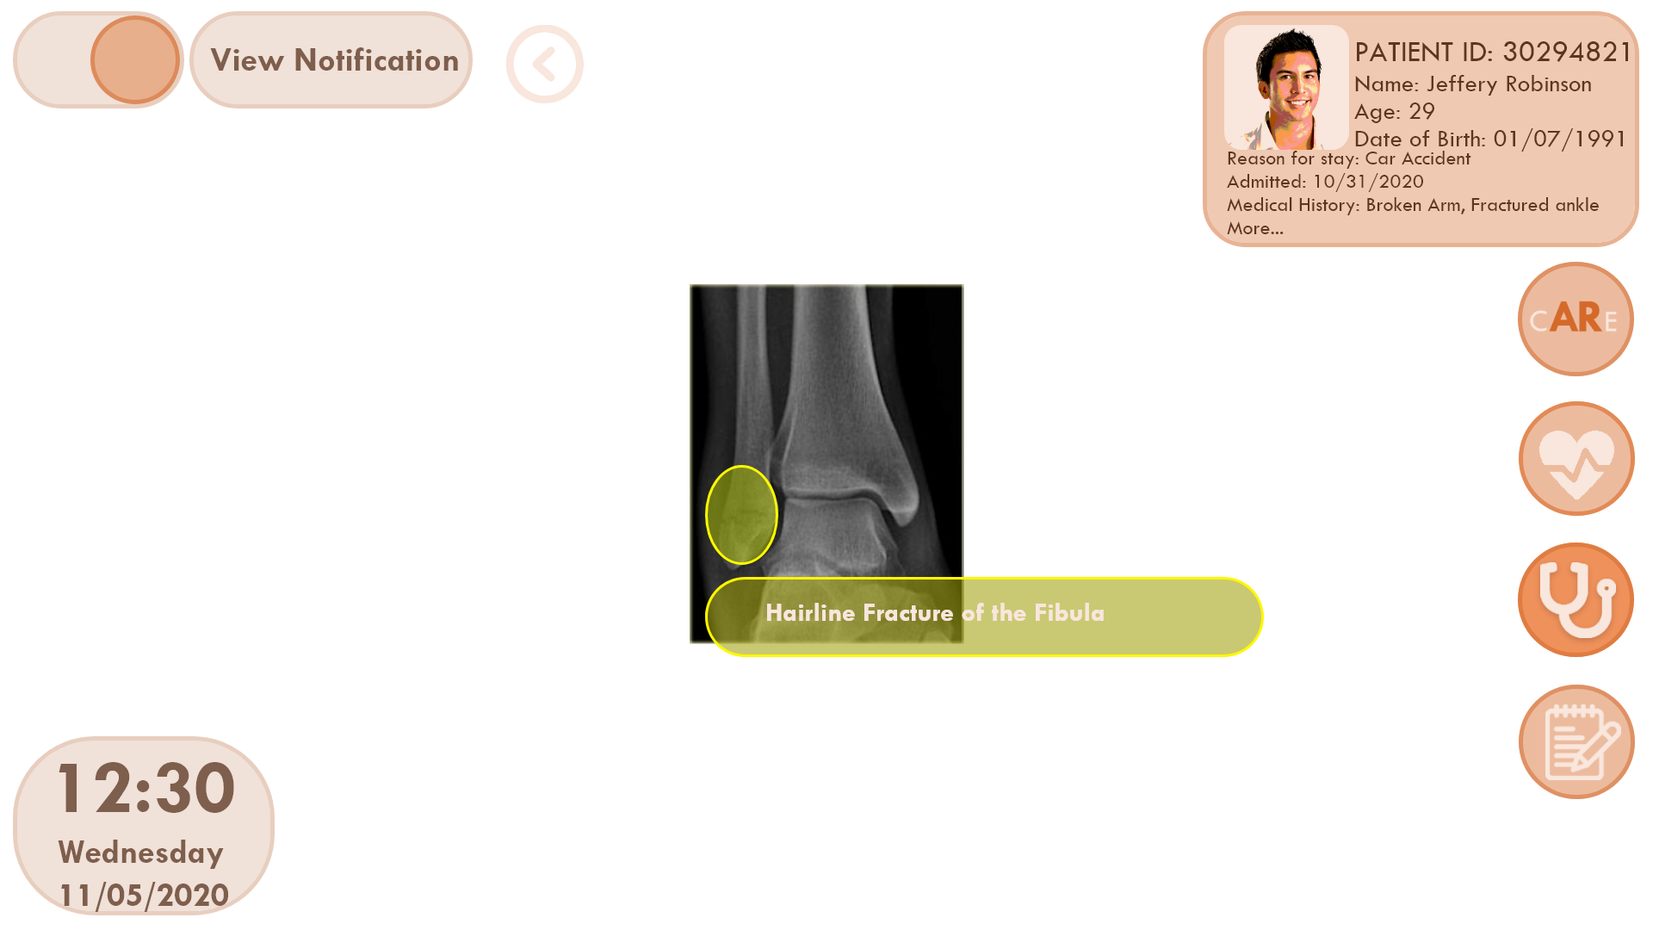
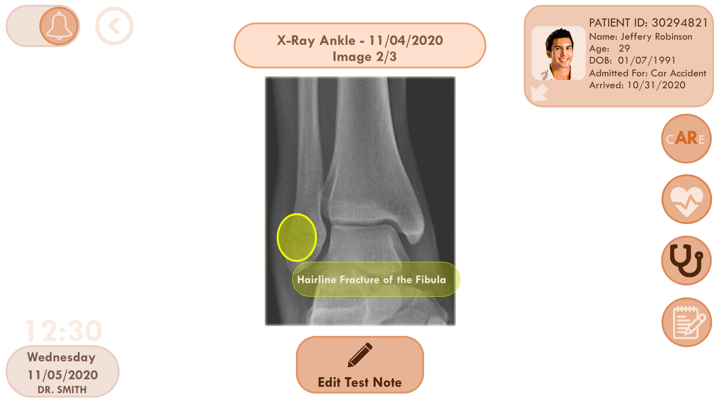
Prototypes: Before and After Evaluation

Slide 16
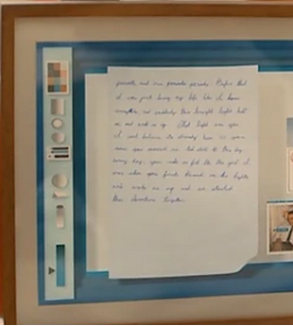
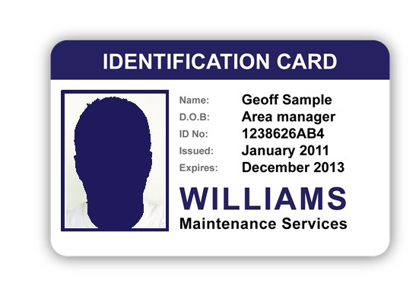
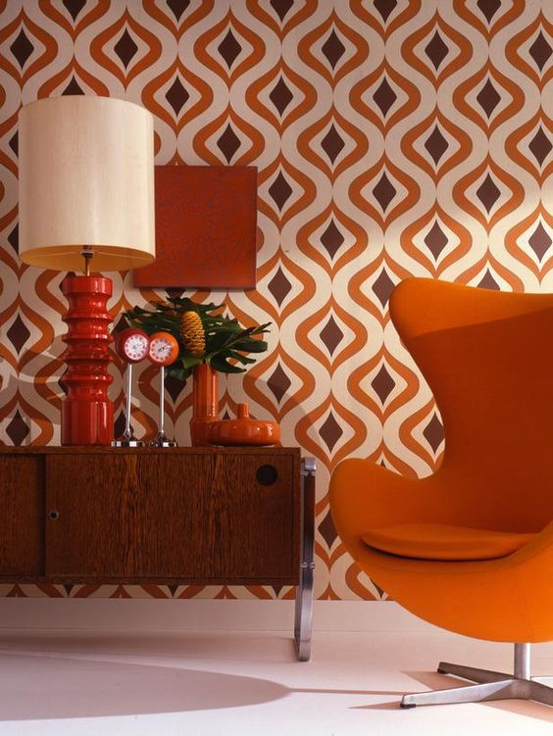
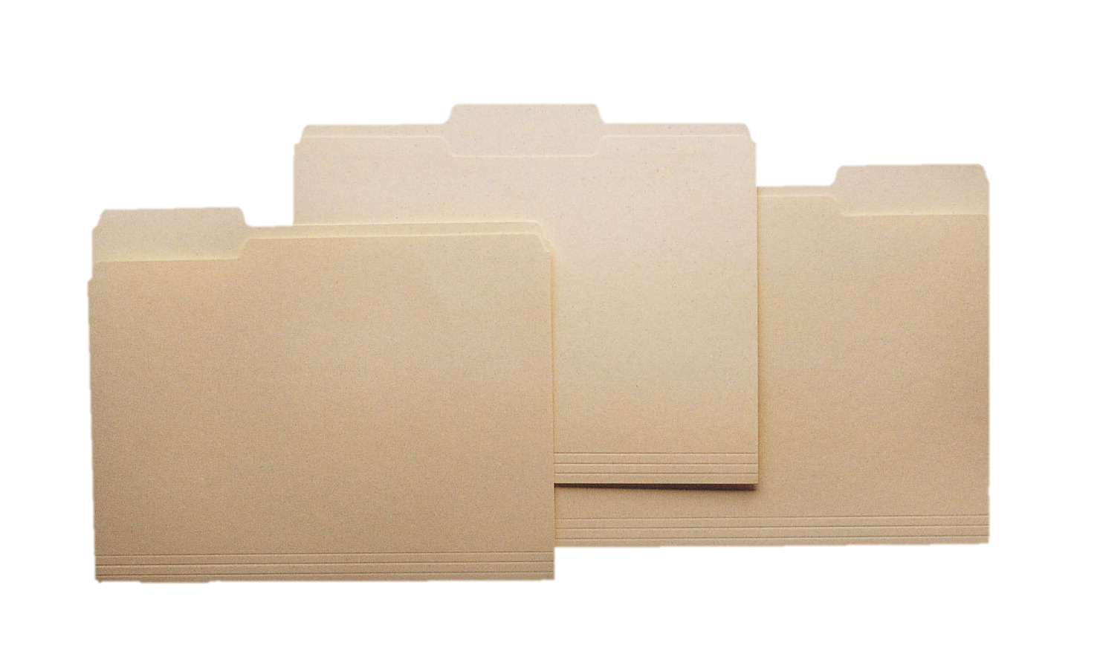
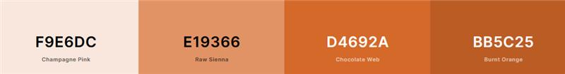
Design Ideas
Notes:
Thanks Navjeet.
Throughout our process we’ve been following design ideas initially put forth near the start of our prototyping.
Even though AR is considered very futuristic we wanted our UX to feel familiar and almost understated compared to a flashy, futurism style.
We chose to go with warmer tones, mid-century modern curves, and components similar to physical objects such as ID cards and file folders.
A source of inspiration is the 2013 film Her, which is set in the future but has very tactile and human UI’s, one such UI shown in the middle picture.

Slide 17


Final Stage Plans
Scan patient’s ID to open their file and close it
Get visual notifications
Add in hands to show gestures
Polish up small details
Notes:
In the final stretch of our project we hope to create and add prototypes for the two remaining tasks;
Entering a patient’s unique ID through the HoloLens keyboard or scanning their hospital wristband to gain access to all their relevant information. Once you are done with a patient, you can clear the screen to close their profile.
And notifying that patients have asked for assistance through external systems or reminding users of scheduled tasks.
Alongside these tasks we want to polish up small details we’ve noticed nearing the end of this stage such as issues with spacing and transparencies.
We also want to add in one of our teammate's actual hands to the video to show off the actual hand gestures needed in the UI.
We look forward to showing off our final prototype. Thank you so much for watching and we hope you have a nice week!

